Slide 1

Safe Path Recommender Using News Feeds
Supervised By: Mr, Usama Musharraf
F22-223
Group Members:
Noman Siddique 19P-1664
Hifza Majeed 19P-1652

Slide 2
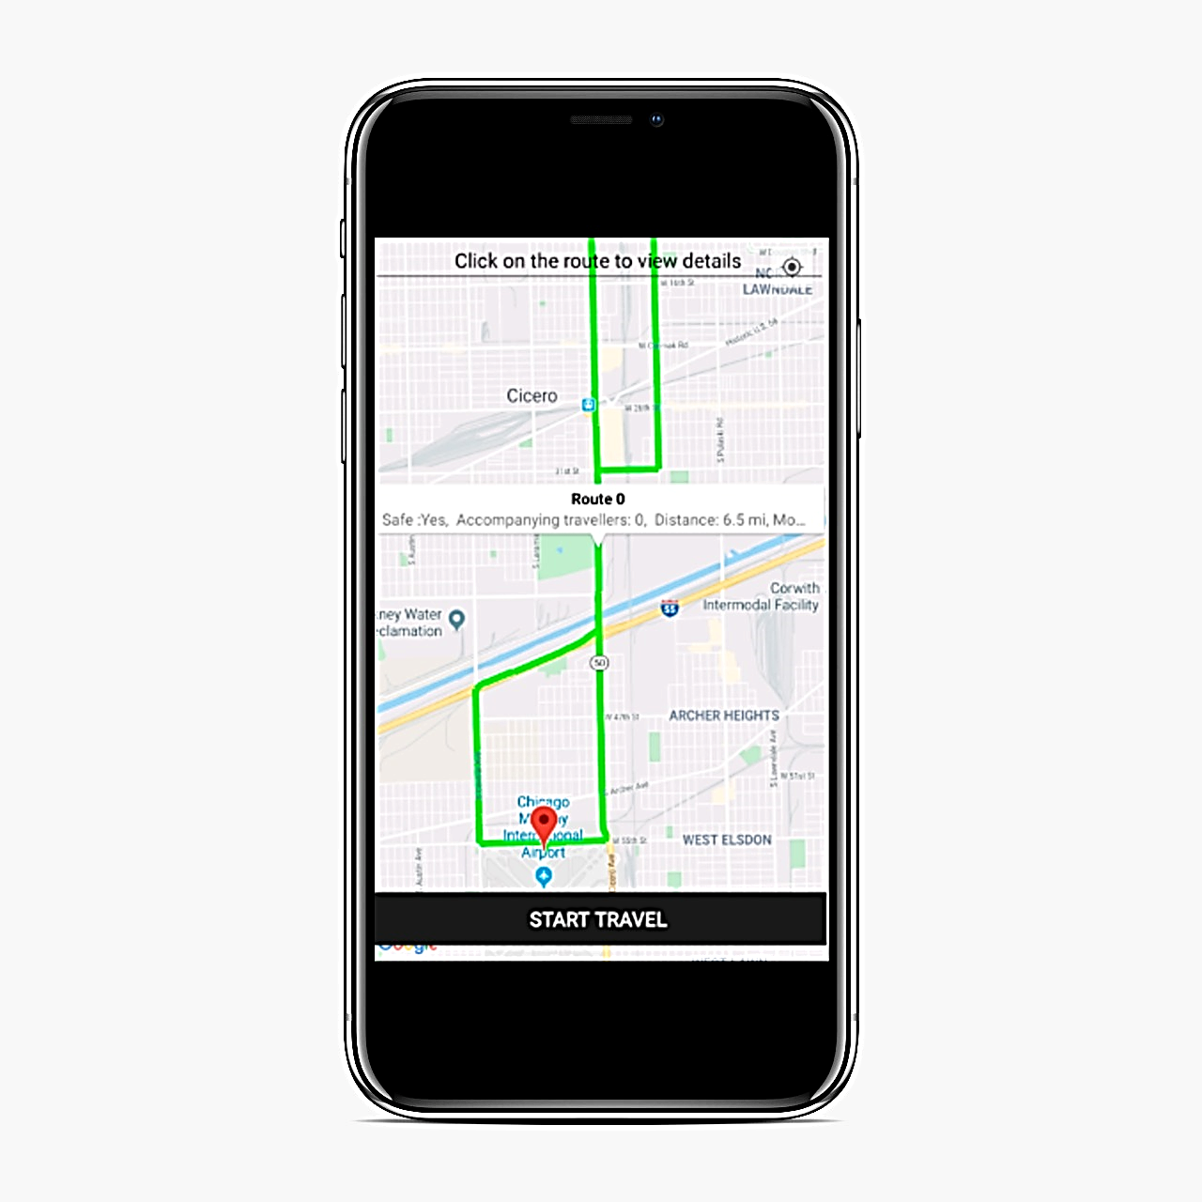
Introduction
Our project aims to develop an application that would recommend safe path to users
The Project holds an immense worth in providing safety like services to citizens
Figure 1: Application Interface

Slide 3
Problem Statement
Currently there is no such system to provide safety like services
Google maps provide
Direction
Distance Matrix
Maximum Zoom Imagery
Street View etc.
But no such direction based on safety concern.
Our system aims to fill this gap developing an application that would cater safety concern of user

Slide 4
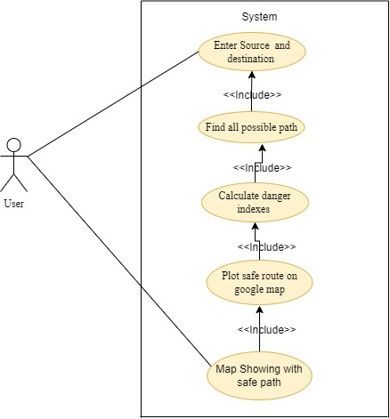
System Analysis
Use Case Diagram:
Figure 2 Use case Diagram

Slide 5
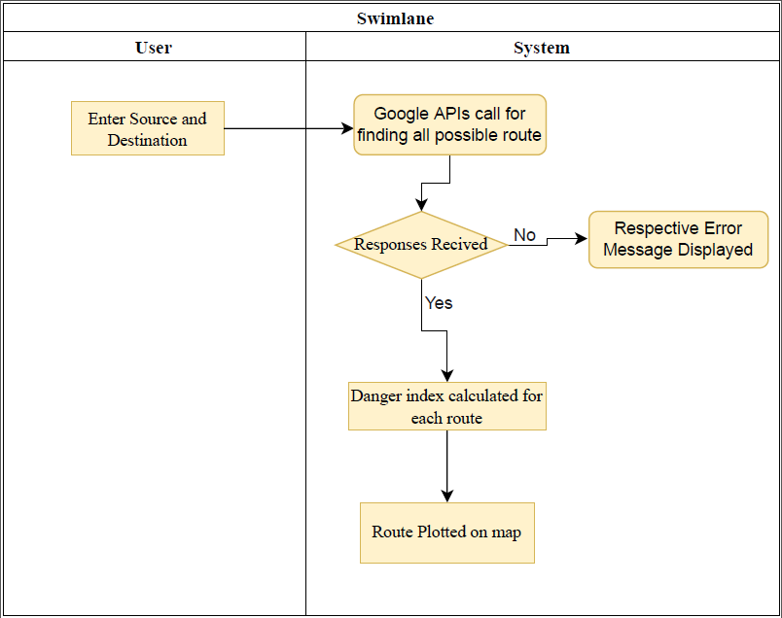
Cont.…
Swimlane Diagram
Figure 3 Swimlane Diagram

Slide 6
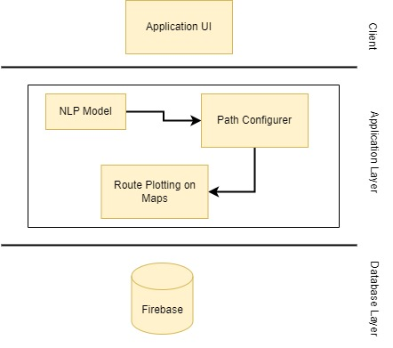
System Design
Abstract View of a Proposed System
Layered Architecture style
Figure 4: Layered Architecture Style

Slide 7
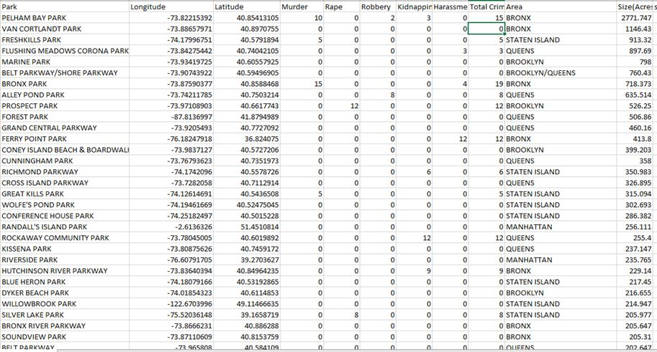
Data Structure/Representation
Figure 5: Data Representation

Slide 8
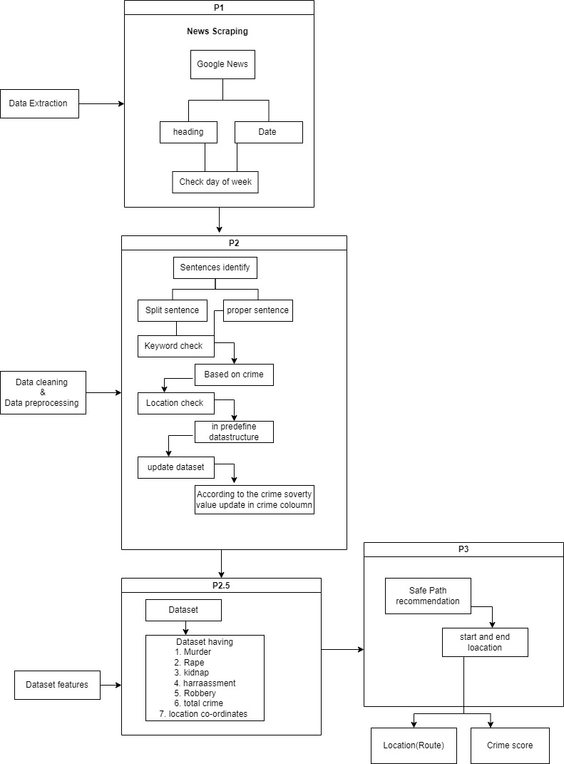
Algorithm/Methodologies
Figure 6: Methodologies

Slide 9
Evaluation Measures/ Testing
Test Case 1:
We compare the result of our(Safe Path Recommender ) application with the Google Map Application.
Test Case 2:
We also check the crime highlight in our Application with that Website info the crime. In the same place

Slide 10
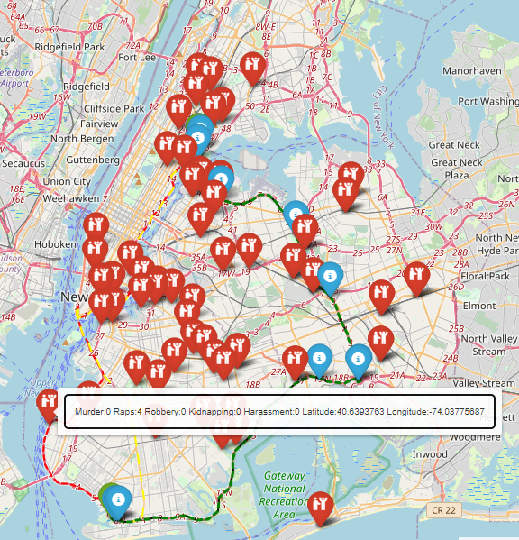
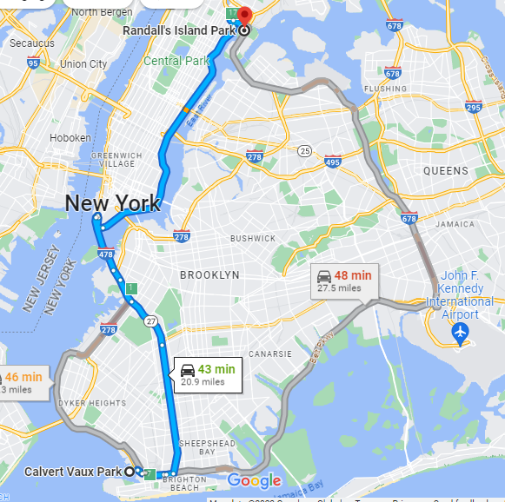
Source: Calvert Vaux Park, Bay 44th St. &, Hunter Ave, Brooklyn, NY 11214, United States Destination: Randall's Island Park, 20 Randalls Island Park, New York, NY 10035, United States Result Test case 1:
Excepted output our Application
Google Map Application

Slide 11
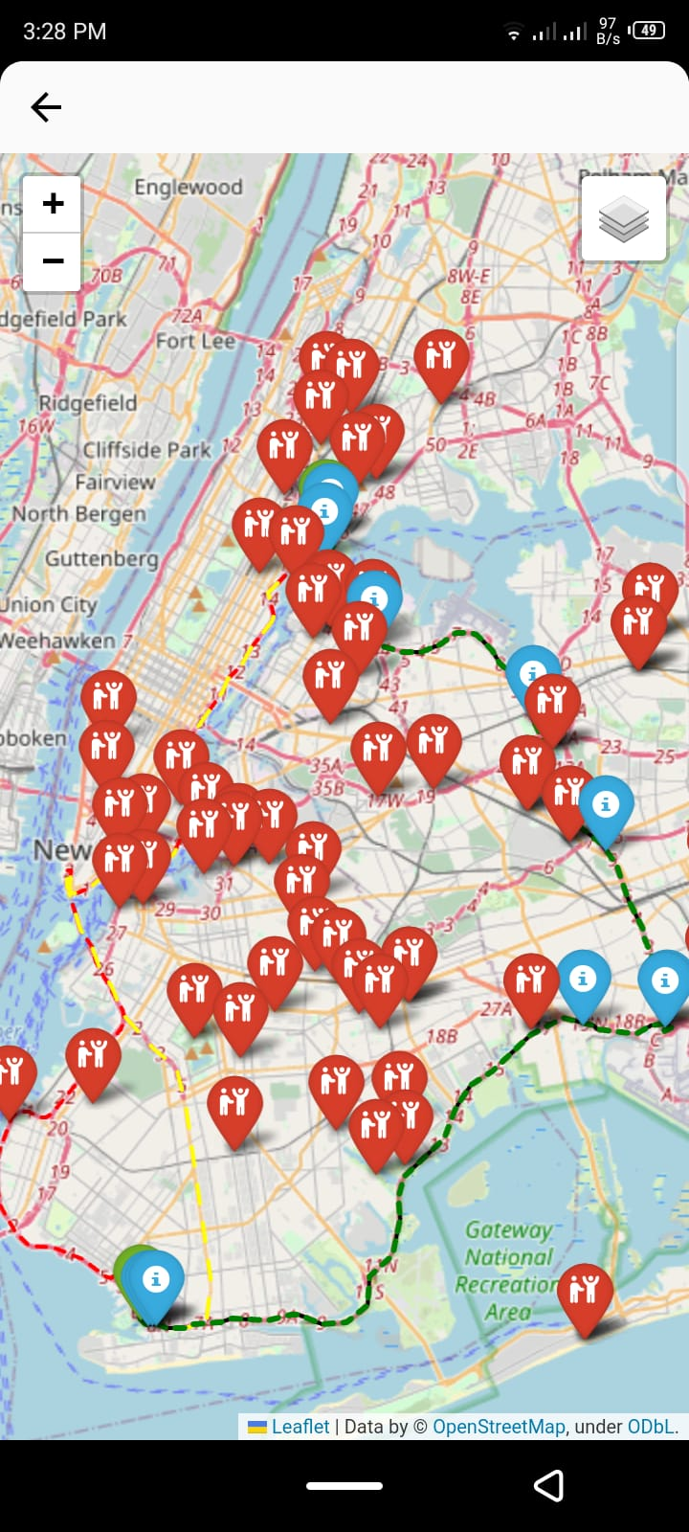
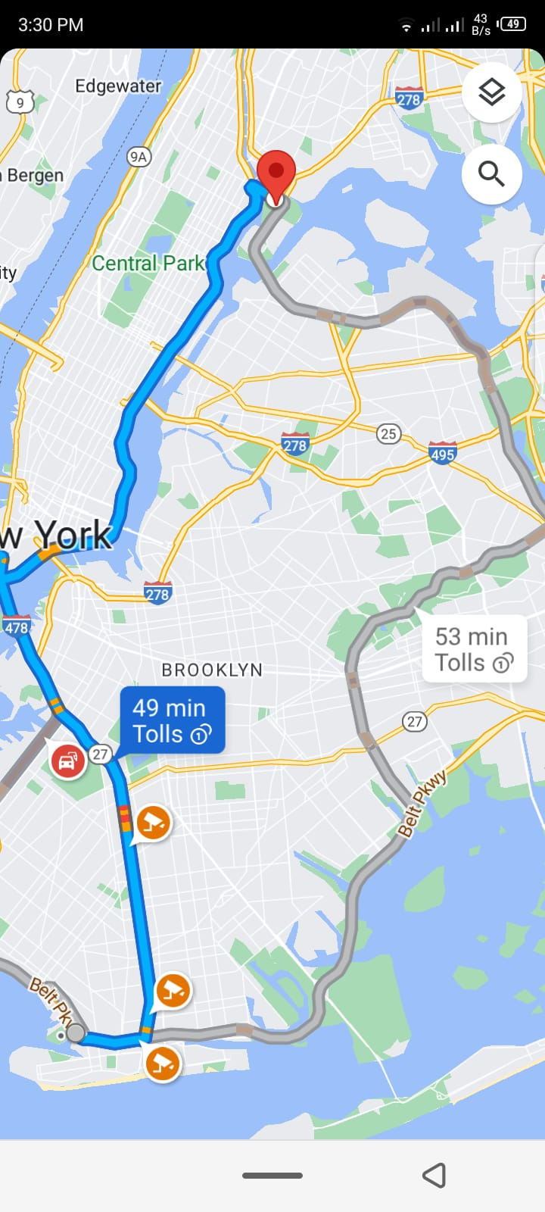
Figure 7: Mobile Base View

Slide 12
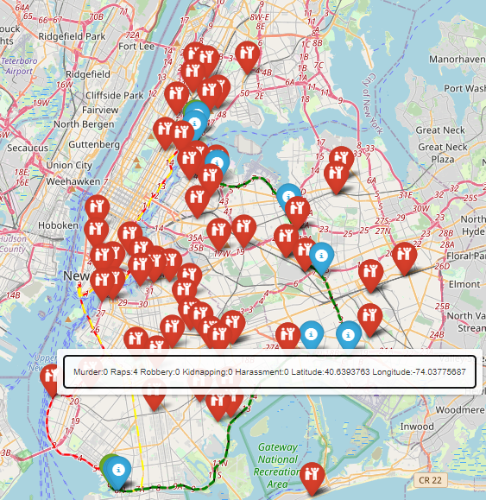
Source: Calvert Vaux Park, Bay 44th St. &, Hunter Ave, Brooklyn, NY 11214, United States Destination: Randall's Island Park, 20 Randalls Island Park, New York, NY 10035, United States Result Test case 2:
Crime Highlight in our Application

Slide 13
DEMO

Slide 14
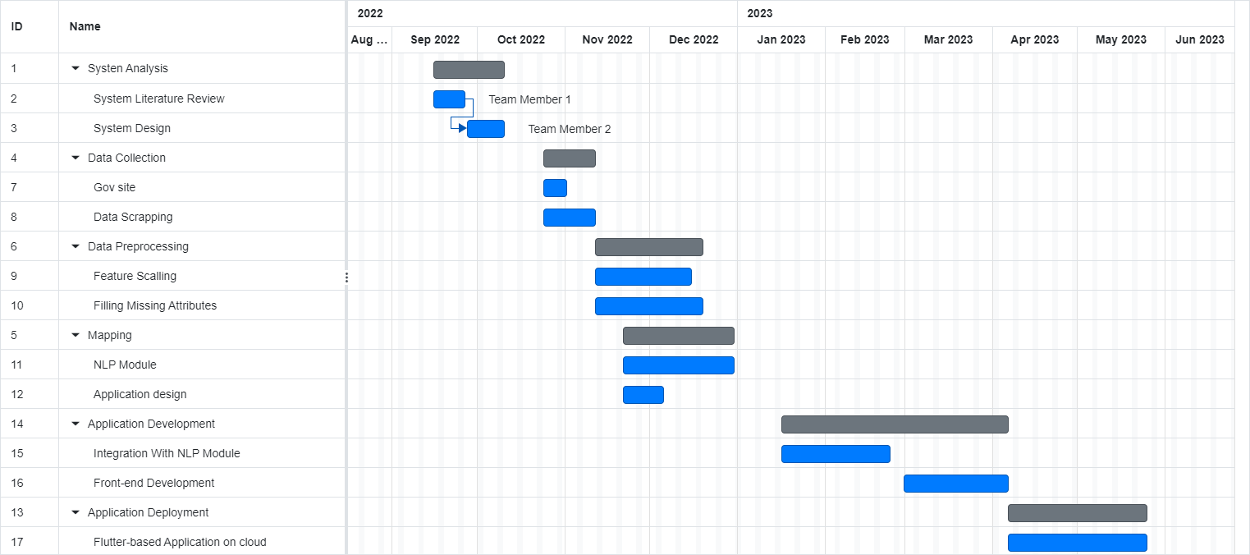
Timeline
Figure 8: Gant Chart

Slide 15

Teamwork
Teamwork
Noman Siddique
Data Collection
Data Preprocessing
NLP module
Hifza Majeed
Application Development
Application Deployment

Slide 16
References
Google, news.google.com/search?q=New+York+crime&hl=en-PK&gl=PK&ceid=PK%3Aen. Accessed 16 May 2023.

Slide 17
Thank You
.

